Slide 1
Chat Models vs Reasoning Models
Learn about the difference between Chat Models vs Reasoning Models

Slide 2
Chat Models

Slide 3
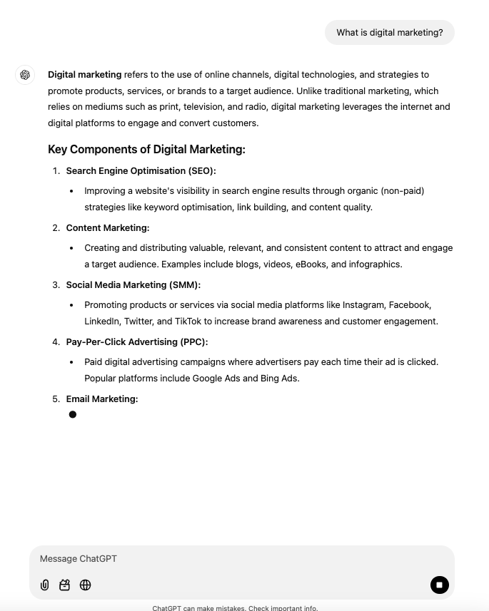
What is a Chat Model?
Chat models are large language models (LLMs) that use a sequence of messages as inputs and return messages as outputs (as opposed to using plain text).

Slide 4
Chat Messages
Chat models have 3 types of messages:
Developer (system) message
User messages
AI messages

Slide 5





Large Language Model Providers
GPT-X series
Claude Sonnet + Claude Opus
Llama series
Google’s Gemini series
Mistral

Slide 6
Chat Model Characteristics
Low Latency: Chat models respond quickly and often stream each word (token) as it is generated.
Reasoning Capabilities: Models such as Claude and GPT-5 are capable at solving easy to medium difficulty tasks.

Slide 7
Reasoning Models

Slide 8
Test Time Compute Scaling
Instead of just making bigger AI models, test-time compute gives models extra processing time during execution to think through problems and refine answers—similar to how humans spend more time on complex tasks.

Slide 9
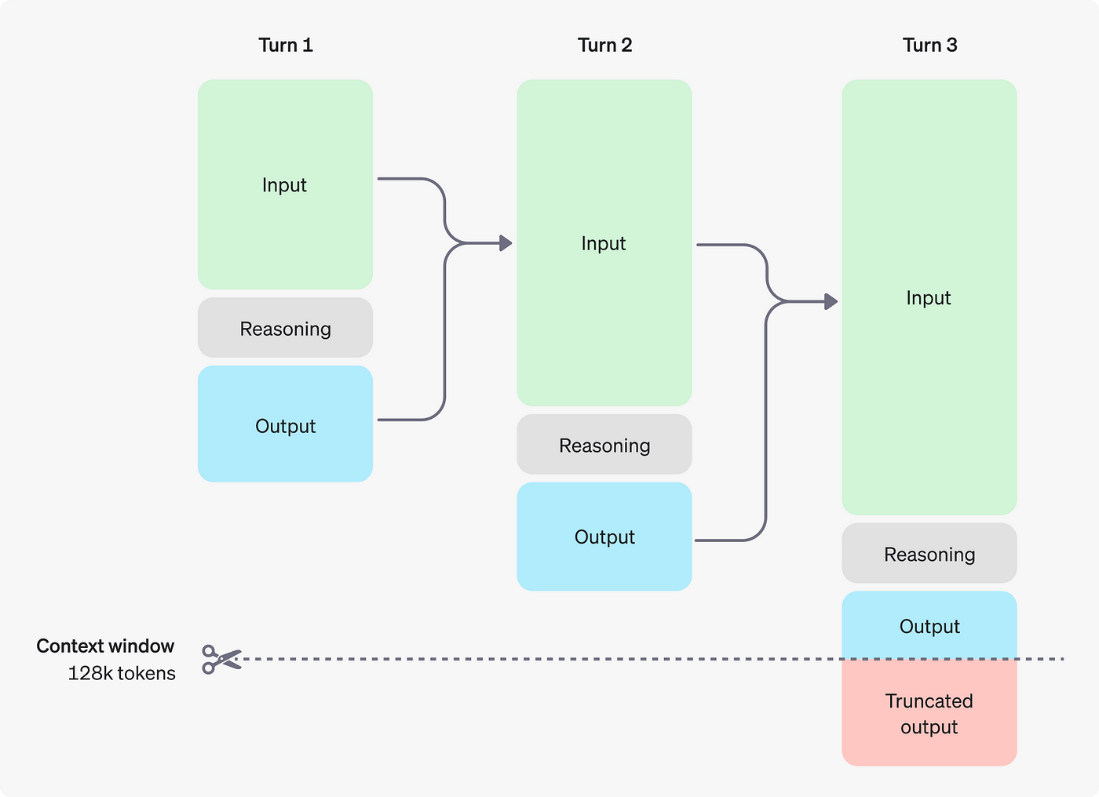
OpenAI - GPT-5 Thinking

Slide 10
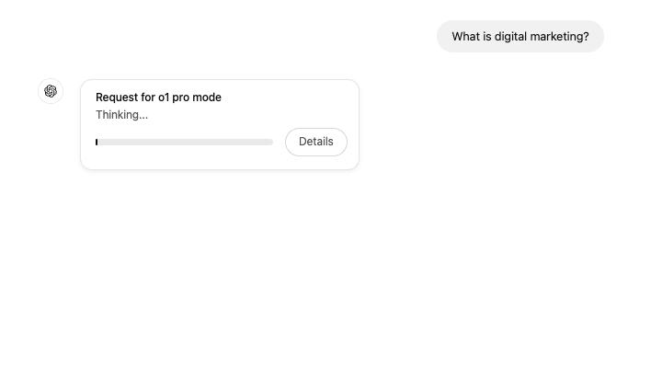
OpenAI - GPT-5 - Thinking Time
Reasoning models will allocate thinking time, before responding to your query.

Slide 11
Reasoning Model Characteristics
High Latency: Reasoning models such as GPT-5 with thinking from OpenAI, which will take longer to respond.
High Reasoning Capabilities: Due to increased test-time compute reasoning, these models often outperform chat models. Reasoning models are much better at solving harder problems.

Slide 12
When To Use A Chat Model / Reasoning Model
Use Case | Chat Model | Reasoning Model (Test-Time Compute)
Content | • Quick emails & posts • Simple summaries | • Technical documentation • Research analysis
Problem Solving | • Basic calculations • Simple Q&A | • Mathematical proofs • Multi-step debugging
Analysis | • Basic data summaries • Quick insights | • Statistical analysis • Pattern recognition
Decision Making | • Simple recommendations • Quick choices | • Risk assessment • Strategic planning

Slide 13
Best Practices
For tasks that require increased accuracy/reduced error use reasoning models.
For tasks such as copywriting or content generation, use smaller models.
Reasoning models take time to respond, so have another task that you’re working on whilst waiting for the response.

